Slide 1



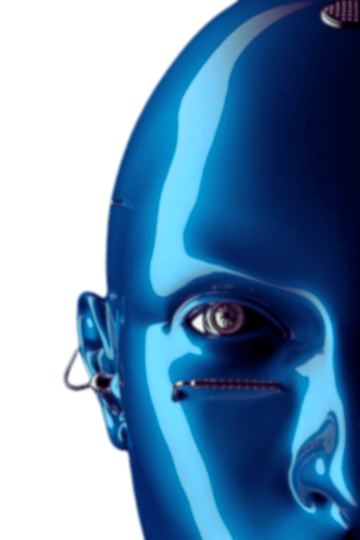

K.A.M.A.L.A
Kapidhwaj Association of Modern logic, Automation, Learning and career Advancement
MENTAL HEALTH CHECK-IN AGENT
An AI-powered chatbot that regularly checks in with users, detects signs of stress or low mood through natural conversation, and offers personalized, positive suggestions like breathing exercises, journaling, or music—acting as a friendly, non-intrusive digital mental health companion available anytime.
PRESENTED BY:
PRESENTED TO:
Your Name: ANUPRIYA
Ai Agents Workshop - Mini Hackathon
Kapidhwaj Innovations Pvt Ltd

Slide 2
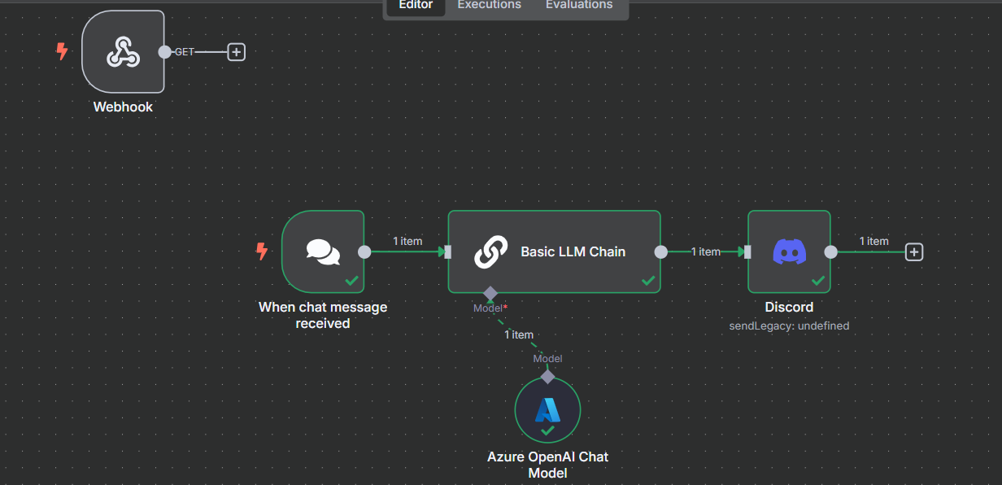
K.A.M.A.L.A
Kapidhwaj Association of Modern logic, Automation, Learning and career Advancement
WORKFLOW DIAGRAM

Slide 3
K.A.M.A.L.A
Kapidhwaj Association of Modern logic, Automation, Learning and career Advancement
🧠 Sentiment Detection Understands emotional tone from text responses
🕒 Autonomous Check-ins Customizable schedule with reminders
💡 Smart Suggestions Breathwork, music, journaling, hydration reminders
📈 Mood History Visual graph of mood over days (user-only access)
🌍 Multilingual Support Can be localized for different regions and cultures
🚨 Distress Handling Gentle alert to helplines when serious issues detected
USE CASE

Slide 4
K.A.M.A.L.A
Kapidhwaj Association of Modern logic, Automation, Learning and career Advancement
Provides non-judgmental emotional support
Helps users build healthy mental habits
Detects early signs of stress and burnout
Is always available and customizable to user needs
Encourages self-reflection without pressure
ADVANTAGES

Slide 5
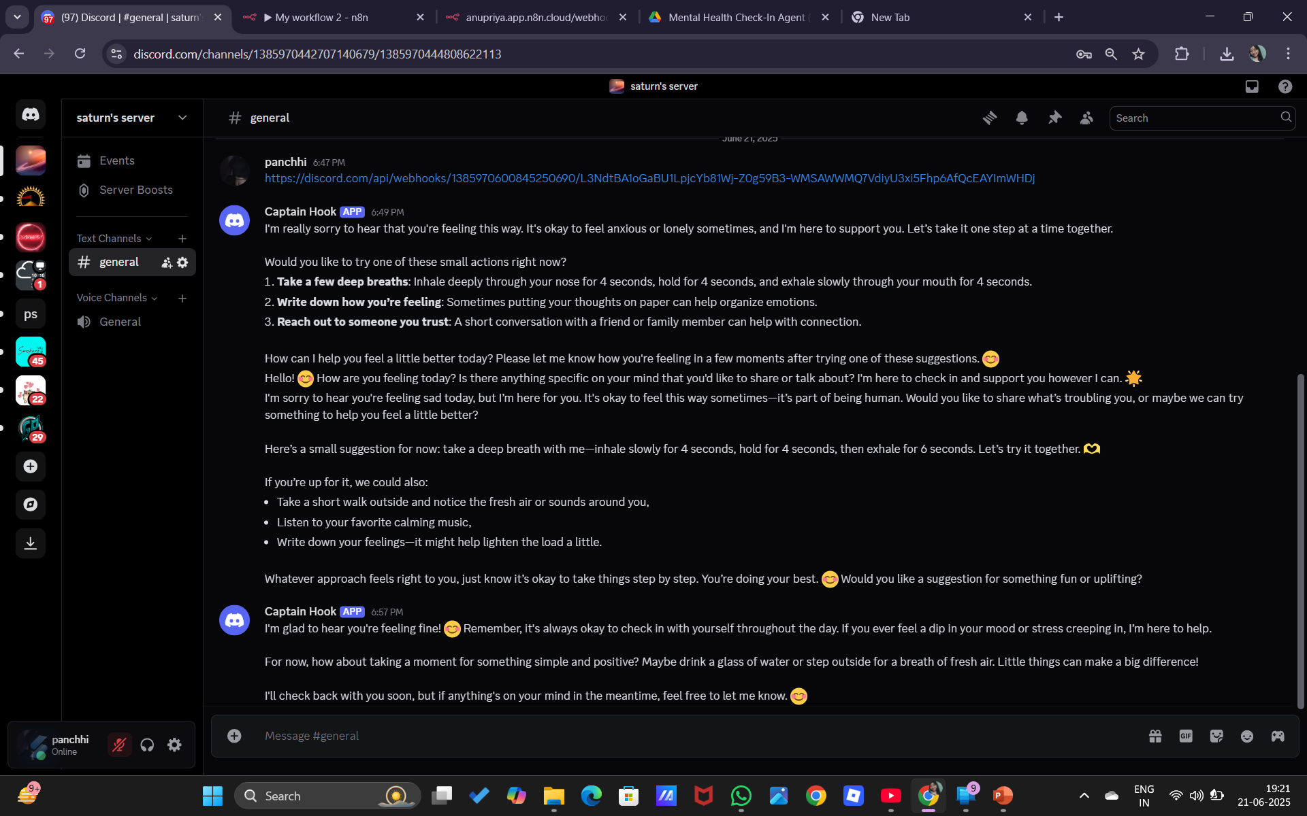
K.A.M.A.L.A
Kapidhwaj Association of Modern logic, Automation, Learning and career Advancement
A screenshot showing the virtual support this agent is providing on discord as automated in the workflow.
Screenshot-1

Slide 6
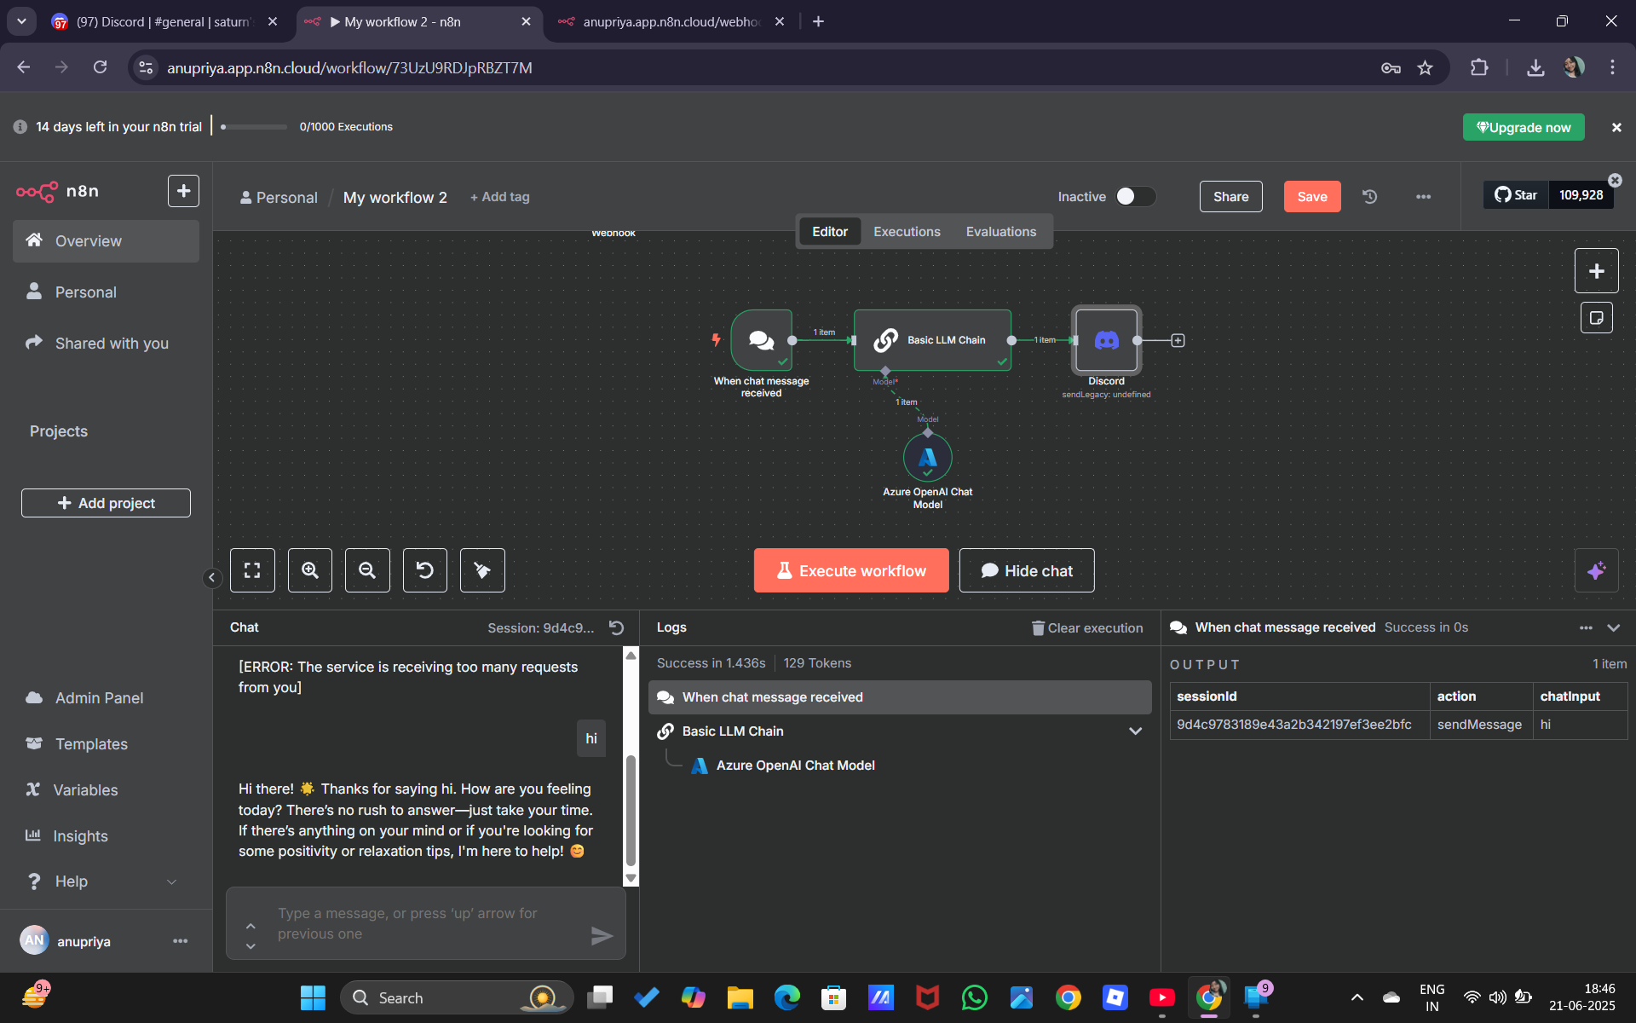
K.A.M.A.L.A
Kapidhwaj Association of Modern logic, Automation, Learning and career Advancement
Screenshot-2
A screenshot showing the virtual support this agent is providing on discord as automated in the workflow.

Slide 7
K.A.M.A.L.A
Kapidhwaj Association of Modern logic, Automation, Learning and career Advancement
FUTURE SCOPE
The Mental Health Check-In Agent can evolve by integrating with wearable devices (like smartwatches) to monitor real-time stress indicators such as heart rate or sleep patterns. Future updates may include emotion recognition through voice or facial analysis, multilingual and culturally adaptive support, and AI-personalized wellness routines. Additionally, it could enable anonymous peer support communities, gamified mental health challenges, and deeper integration with therapy platforms—making it a holistic tool for emotional well-being and preventive mental health care.

